Slide 1

Query Store Basics: A DBA’s Best Friend
Ever wondered why your queries are running differently today than they did last week? Query Store in SQL Server can help you figure that out! In this session, we’ll break down the basics of Query Store, designed especially for junior or accidental DBAs. We’ll talk about what Query Store does, how it works and how it evolved over time, and why it’s such a great tool for keeping track of query performance over time. With explanations and demos, you’ll learn how to use Query Store to spot performance issues, dig into query execution plans, and even prevent bad plans from ruining your day. If you’re new to SQL Server or just looking for a practical way to optimize query performance, this session will help you to get started.

Slide 2
Probably Sponsors
Notes:
How to see content of it..

Slide 3




Peter Kruis
https://www.linkedin.com/in/peter-kruis
peterkruis@hotmail.com / peter.kruis@monin-it.be
https://github.com/peterkruis

Slide 4
Before Query Store…
Notes:
Before Query Store, troubleshooting performance issues was... let's say, 'fun’...
TODO: Image frustrated DBA’s

Slide 5
“My query was fast last week, and now it’s slow! Who broke it?!” or.. “What have you done that it is broken”
Ugh… let me go dig through the plan cache… oh wait, it’s been flushed. Guess I’ll need to capture it next time it runs!

Slide 6
“I swear I didn't change anything, but now it's running terribly!”
Did someone rebuild indexes, update stats, or change a setting? No? I don’t have time to play 'Guess the Execution Plan' again!
Notes:
Before Query Store, troubleshooting performance issues was... let's say, 'fun’...
TODO: Image frustrated DBA’s

Slide 7
“Yesterday’s execution plan was perfect. Today? A disaster!”
I hope someone saved it manually… because SQL Server sure didn’t!
Notes:
Before Query Store, troubleshooting performance issues was... let's say, 'fun’...
TODO: Image frustrated DBA’s

Slide 8
“The query runs fine on my machine… must be the database!”
Ah yes, the classic developer excuse! Are you running it with the same parameters? Same data volume? No? Thought so.
Notes:
Before Query Store, troubleshooting performance issues was... let's say, 'fun’...
TODO: Image frustrated DBA’s

Slide 9
“Help! The same query gives different results in performance every time!”
Parameter sniffing strikes again! Maybe try OPTION (RECOMPILE)… or just keep praying for a good plan.
Notes:
Before Query Store, troubleshooting performance issues was... let's say, 'fun’...
TODO: Image frustrated DBA’s

Slide 10
“We upgraded SQL Server, and now everything is slower… what happened?!”
Oh boy, the upgrade probably changed the cardinality estimator or optimizer behavior. Time to roll back, test, or pray.
Notes:
Before Query Store, troubleshooting performance issues was... let's say, 'fun’...
TODO: Image frustrated DBA’s

Slide 11
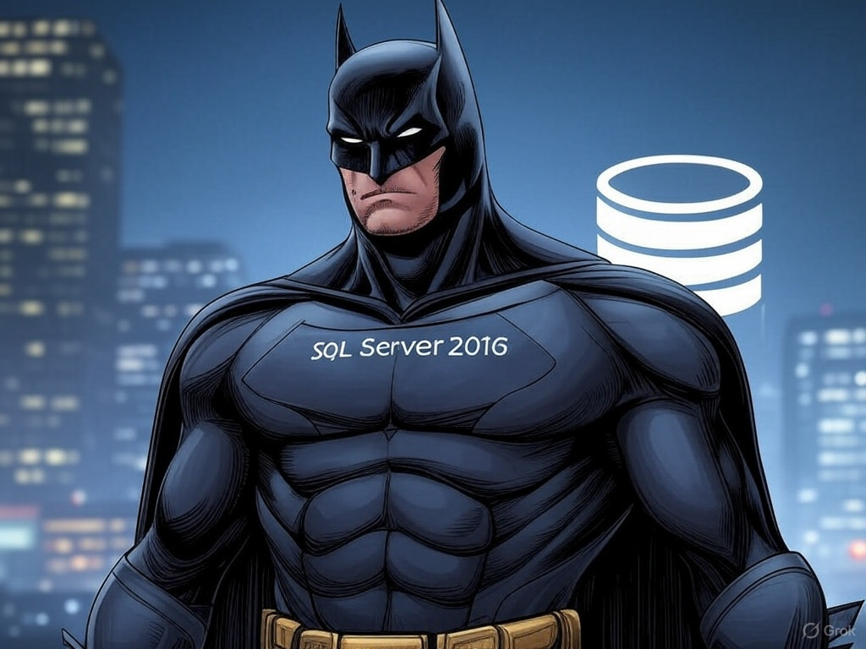
And then… SQL Server 2016 Was Released!
Notes:
No more guessing games! SQL Server 2016 introduces Query Store!

Slide 12
And it came with Query Store..
But.. What is it, and how does it help you?
Black box of what happens within your database(s)
Captures execution plans automatically over time
Helps identifying plan regressions
Allows plan forcing
Stores performance history
Notes:
So it will make your job more pro-active instead of reactive..

Slide 13
2014
2015
2016
2017
2019
2022
2025
Evolution
Initial preview
Concept + vision
Notes:
Connor Cunningham, known for his work on the SQL Server Query Processor, first discussed a preview of Query Store around 2014

Slide 14
2014
2015
2016
2017
2019
2022
2025
Evolution
March: Public Preview within Azure SQL DB
Mid-year: GA within Azure SQL DB
Notes:
2015 it became available as Public Preview within Azure SQL Databases
This was part of the Azure first strategy, where new features would debut in Azure before they made it into the on-premise toolbox
Later in 2015 it became generally available in Azure SQL Database

Slide 15
2014
2015
2016
2017
2019
2022
2025
Evolution
June: SQL Server 2016
GUI Support within SSMS
Plan forcing
Capture policies
Notes:
SQL Server 2016 is the first on-premise version where it is available.
It was immediately a powerful tool, but, the defaults should be changed

Slide 16
2014
2015
2016
2017
2019
2022
2025
Evolution
(Performance) Optimizations
Notes:
How did it evolve over time? As SQL 2016 is almost out of support, did it enhance over time?

Slide 17
2014
2015
2016
2017
2019
2022
2025
Evolution
Query store wait stats
Custom plan capture policies
Memory and concurrency improvements
Notes:
How did it evolve over time? As SQL 2016 is almost out of support, did it enhance over time?

Slide 18
2014
2015
2016
2017
2019
2022
2025
Evolution
Enabled by default for new databases
Automatic plan correction
Integration with automatic tuning
Inject query hints
Notes:
How did it evolve over time? As SQL 2016 is almost out of support, did it enhance over time?

Slide 19
2014
2015
2016
2017
2019
2022
2025
Evolution
Query store on readable secondaries
Integration with Intelligent Query Processing
Degree of Parallelism auto adjustments
Optional Parameter Plan Optimization
Notes:
Keep in mind, it is public preview, so subject to change

Slide 20
How does it work?
Query
In memory
Query text + plans
Compilation -> Query text + plan
Compilation
Runtime / execution stats
Duration, CPU etc
Wait information (2017+)
Runtime / execution stats
Duration, CPU etc
Wait information
Execution
Execution -> Metrics
Async (DATA_FLUSH_INTERVAL_SECONDS)
Query store internal tables within your database
Notes:
So, within the database where Query store is enabled, there are some
The metrics will be saved in memory first. This is needed to not overflood your IO processes.
When queries get’s compilated and executed, the data will be retrieved.
When compiling, it knows the query and the plan. This will be saved to disk ASAP
When executing, the runtime metrics (including waits since 2017) are saved to memory. This are being written to disk async.
When retrieving data from the tables, it will combine the data from both the memory + disk
Bij on disk, houdt het dus in, dat wanneer je een restore doet van de database, of een CloneDB, dan heb je ook de info van QS beschikbaar
How does it work?
https://learn.microsoft.com/en-us/sql/relational-databases/performance/how-query-store-collects-data?view=sql-server-ver16

Slide 21
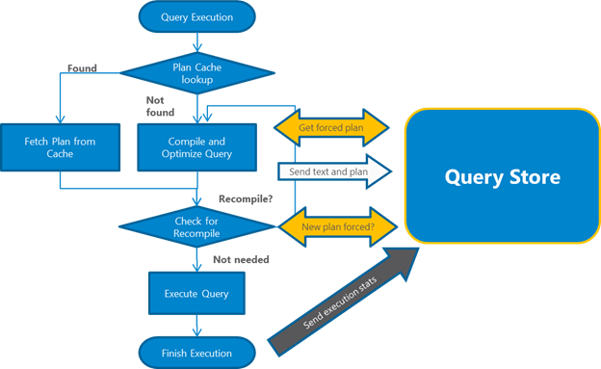
How does it work?
Image from https://learn.microsoft.com/en-us/sql/relational-databases/performance/how-query-store-collects-data?view=sql-server-ver16
Notes:
Query execution and query store

Slide 22
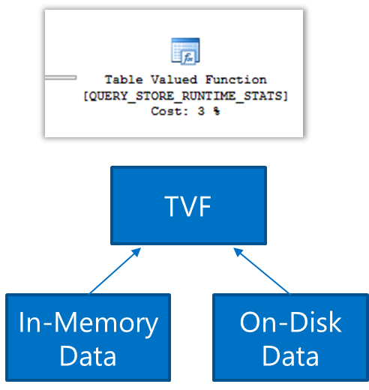
How does it work?
Notes:
So, when retrieving the data, data will be combined from data in memory and data on disk.

Slide 23
Objects (1)
Table Name | Description
sys.query_store_query | Metadata about the captured query (e.g., query ID, object ID, parameterization).
sys.query_store_query_text | The actual text of the query as executed.
sys.query_store_plan | Execution plans linked to each query.
sys.query_store_runtime_stats | Runtime execution statistics per plan per interval (CPU, IO, duration).
sys.query_store_runtime_stats_interval | Time intervals used to group runtime statistics.
sys.query_store_wait_stats | Wait statistics per plan per interval.
Notes:
Welke tabellen zijn er waar er wordt opgeslagen.
Mogelijk nog uitgangspunten?
1 periode, meerdere queries, 1 query kan weer meerdere plannen hebben?

Slide 24
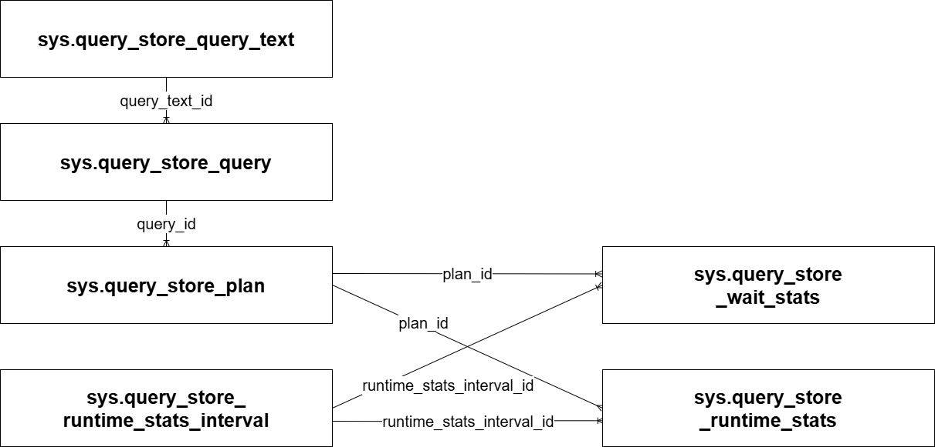
Objects (2)
Notes:
Welke tabellen zijn er waar er wordt opgeslagen.
Mogelijk nog uitgangspunten?
1 periode, meerdere queries, 1 query kan weer meerdere plannen hebben?

Slide 25
Objects (3)
Table Name | Description
sys.query_store_plan_feedback | Stores feedback about query plans and suggestions for improvements.
sys.query_store_plan_forcing_locations | Details about where a plan forcing is applied.
sys.query_store_query_hints | Query hints applied via Query Store.
sys.query_store_query_variant | Query variants, for example due to parameterization.
sys.query_store_replicas | Replica information for AlwaysOn Availability Groups.
sys.query_context_settings | Query context settings.
sys.database_query_store_internal_state | Internal status and space usage of Query Store.
sys.database_query_store_options | Configuration options of Query Store.
Notes:
Some other tables which are used

Slide 26
Remarks
It must be enabled at database level
Cannot be enabled for master or tempdb
model database can be done using T-SQL
Enabled by default for Azure SQL DB and Azure SQL Managed Instance databases
Enabled by default starting SQL Server 2022
Notes:
What will it capture, what will it not caputre

Slide 27
Captures
Captured (depends on capture mode)
DML
Statements
Stored Proc
Functions
Triggers
Not captured
DDL
BULK INSERT
DBCC, KILL etc.
Showplan
Other database context
“Who/Where”
Notes:
It will capture, however that depends on the capture mode (will come back on that in the next sheets)
Won’t capture
I did see some index creations sometimes though..

Slide 28
Configuring
T-SQL
ALTER DATABASE <database_name> SET QUERY_STORE = ON (OPERATION_MODE = READ_WRITE);
SSMS gui
In Object Explorer, right-click a database, select properties
In the disalog box, select the Query Store page
In the Operation Mode (Requested), select Read Write
Notes:
You can enable it with T-SQL and SSMS.
In both cases keep in mind that several settings should be configured
Next to those settings -> Traceflags

Slide 29
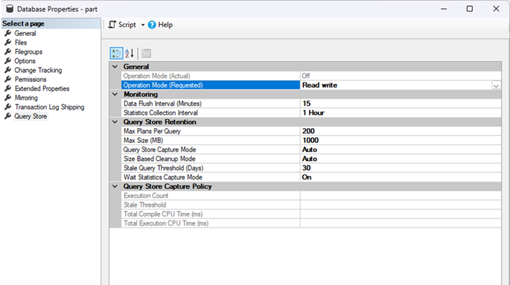
Configuring
Notes:
When enabling, you should check some of the settings. Let’s go through them
Operation Mode (Requested), well, you want to capture some data, right?
Data Flush Interval, how often will it be written do disk
Collection interval, time windows for analysing
This may be high, however, getting it lower will increase sized (default is 1 hour)
Statistics are summarized within the interval, so example, a query ran 5 times with an average of 1 second and the maximum of it was 5 seconds.
Max plans per query (says what it is)
Max size (is it enough for your workload?)
Capture mode: All, or just relevant, CUSTOM has been added in SQL 2019. ALL will have the most overhead
Size based cleanup, when this is off, it will fill but not clean, so it will switch to read-only
Threshold: how long you want to keep the data?
Waits: also capture waits
For the custom
Execution count, when a query exectutes < x times, it won’t be captured
Stale, sets the windows of time for query evaluation
Total compile, when set, when a query that uses more time than this for compiling, it will be tracked
Total execute, when set, when a query that uses more time than this for compiling, it will be tracked

Slide 30
Configuring
ALTER DATABASE <database_name>
SET QUERY_STORE = ON (
OPERATION_MODE = READ_WRITE,
CLEANUP_POLICY = (STALE_QUERY_THRESHOLD_DAYS = 30),
DATA_FLUSH_INTERVAL_SECONDS = 900,
INTERVAL_LENGTH_MINUTES = 60,
MAX_STORAGE_SIZE_MB = 1000,
QUERY_CAPTURE_MODE = AUTO,
SIZE_BASED_CLEANUP_MODE = AUTO,
WAIT_STATS_CAPTURE_MODE = ON
);
Notes:
When enabling, you should check some of the settings. Let’s go through them
Operation Mode (Requested), well, you want to capture some data, right?
Collection Data Flush Interval, how often will it be written do disk
Interval_length_minutes, time windows for analysing
This may be high, however, getting it lower will increase size
Max plans per query (says what it is)
Max size (is it enough for your workload?)
Capture mode: All, or just relevant, CUSTOM has been added in SQL 2019. ALL will have the most overhead
Size based cleanup, when this is off, it will fill but not clean, so it will switch to read-only
Threshold: how long you want to keep the data?
Waits: also capture waits
For the custom
Execution count, when a query exectutes < x times, it won’t be captured
Stale, sets the windows of time for query evaluation
Total compile, when set, when a query that uses more time than this for compiling, it will be tracked
Total execute, when set, when a query that uses more time than this for compiling, it will be tracked
Query Store cleanup kicks in when it consumes 90% of its maximum size (MAX_STORAGE_SIZE_MB) ▪ Cleanup also regularly occur to keep only the last N days of data (STALE_QUERY_THRESHOLD_DAYS)
Uitzoeken hoeveel data er ongeveer in past per hoeveel MB.

Slide 31
Trace Flags
Traceflag 7752
This traceflag will allow queries to execute while Query Store loads it’s data asynchronously when starting up.
New data won’t be collected during this period
This is the default behaviour since SQL Server 2019
Traceflag 7745
This traceflag will bypass the waiting for the Query Store data being written to disk at a shutdown.
Some data may be lost, the amount depends on the configuration
Notes:
How to see content of it..

Slide 32
Yeah, yeah, enough talking..
Notes:
How to see content of it..

Slide 33
DEMO
Notes:
Enable Query Store
Where to find
How to configure
GUI + script

Slide 34
DEMO
Notes:
Reports
Look into the reports, what are they
Some information about the reports, where to find and how to configure
Icoontjes
Square – Cancelled
Circle – Succesvolle executions
Triangle- Error
Plan forcing

Slide 35
DEMO
Notes:
SQL
Find information within the tables from Query Store
Plan forcing
Query hint (niet via GUI)
Force plan, make it invalid, see that it still works
Quicky store

Slide 36
Feedback
Notes:
How to see content of it..

Slide 37
Learn more?
Notes:
Want to learn more?
Links naar goede learnings, bv Erin
https://www.pluralsight.com/courses/sqlserver-query-store-introduction
Sp_quickiestore
https://erikdarling.com/sp_quickiestore/

Slide 38
References
https://learn.microsoft.com/en-us/sql/relational-databases/performance/how-query-store-collects-data?view=sql-server-ver16
Notes:
How to see content of it..

